Slide 1
Particle Physics Event Classification
By Sai Subba Rao Mahendrakar

Slide 2
Dataset Overview :
Size: ~250,000 events
Features: 30 real-valued physics measurements per event (kinematic properties of particles)
Target Variable: ”Label”
s → signal (events resembling Higgs boson decays)
b → background (other particle physics processes)

Slide 3
Data Preprocessing :
Dropped EventId (not predictive)
Replaced -999 with NaN (missing values)
Dropped features with >70% missing or low correlation
Final dataset shape: (250,000, 21)
Outlier capping using IQR method
Fixed skewness using PowerTransformer (Yeo-Johnson)

Slide 4
Feature Engineering :
Checked correlation with target
Performed VIF (Variance Inflation Factor) to reduce multicollinearity
Dropped high-VIF features: DER_sum_pt, DER_pt_ratio_lep_tau, PRI_jet_num
Final feature set: 17 predictors + 1 target

Slide 5
Model Selection :
Tried advanced ML model: XGBoost Classifier
Why XGBoost?
Handles non-linearity well
Regularization prevents overfitting

Slide 6
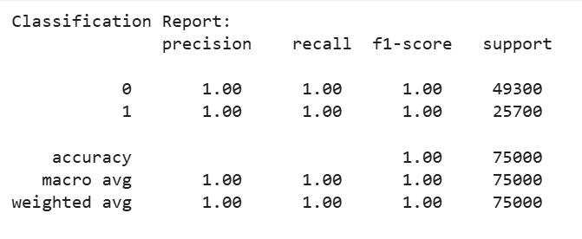
Results & Insights :
XGBoost achieved perfect classification on test data
Strong separation between signal & background
Possible reasons:
Dataset simulated (not noisy like real-world data)
Feature set very rich → high separability

